Slide 1
ARTIFICIAL INTELLIGENCE
&
MACHINE LEARNING
SESSION NO :14
Derivatives, gradient descent.

Slide 2
Definition of a Derivative
In mathematics, the derivative is a fundamental tool that quantifies the sensitivity to change of a function's output with respect to its input.
The derivative of a function of a single variable at a chosen input value, when it exists, is the slope of the tangent line to the graph of the function at that point.
The tangent line is the best linear approximation of the function near that input value.

Slide 3
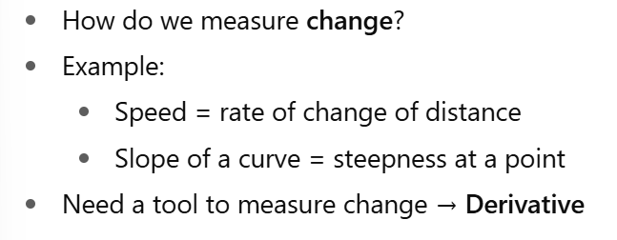
Definition of a Derivative
Example :

Slide 4
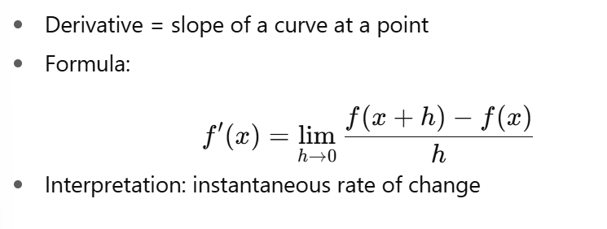
Definition of a Derivative
Example :

Slide 5
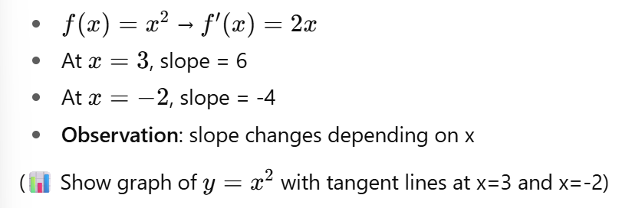
Definition of a Derivative
Example :

Slide 6
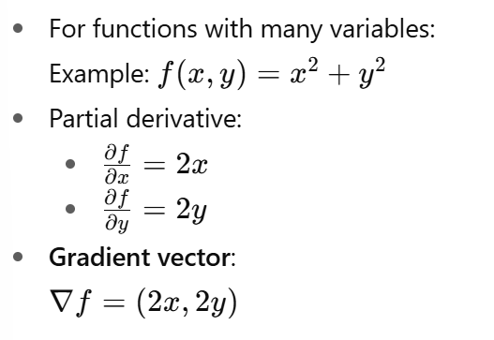
Definition of a Derivative
Partial Derivatives

Slide 7

Rules of a Derivative
Some basic rules of taking derivatives
Sum Rule: ${\left(f\left(x\right)+g\left(x\right)\right)}^{′}=f^{′}\left(x\right)+g^{′}\left(x\right)$
Scaling Rule: ${\left(a⋅f\left(x\right)\right)}^{′}=a⋅f^{′}\left(x\right)$ if $a$ is not a function of $x$
Product Rule: ${\left(f\left(x\right)⋅g\left(x\right)\right)}^{′}=f^{′}\left(x\right)⋅g\left(x\right)+g^{′}\left(x\right)⋅f\left(x\right)$
Quotient Rule: $\left(f\left(x\right)/g\left(x\right)\right)′=\left(f^{′}\left(x\right)⋅g\left(x\right)−g^{′}\left(x\right)f\left(x\right)\right)/{\left(g\left(x\right)\right)}^{2}$
Chain Rule: ${\left(f\left(g\left(x\right)\right)\right)}^{′}≝{\left(f∘g\right)}^{′}\left(x\right)=f^{′}\left(g\left(x\right)\right)⋅g^{′}\left(x\right)$

Slide 8
Optimization
In the context of machine learning, optimization refers to the process of adjusting the parameters of a model to minimize (or maximize) some objective function.
There are various optimization algorithms used in machine learning to find the optimal set of parameters.
These algorithms are responsible for updating the model parameters iteratively during the training process.

Slide 9
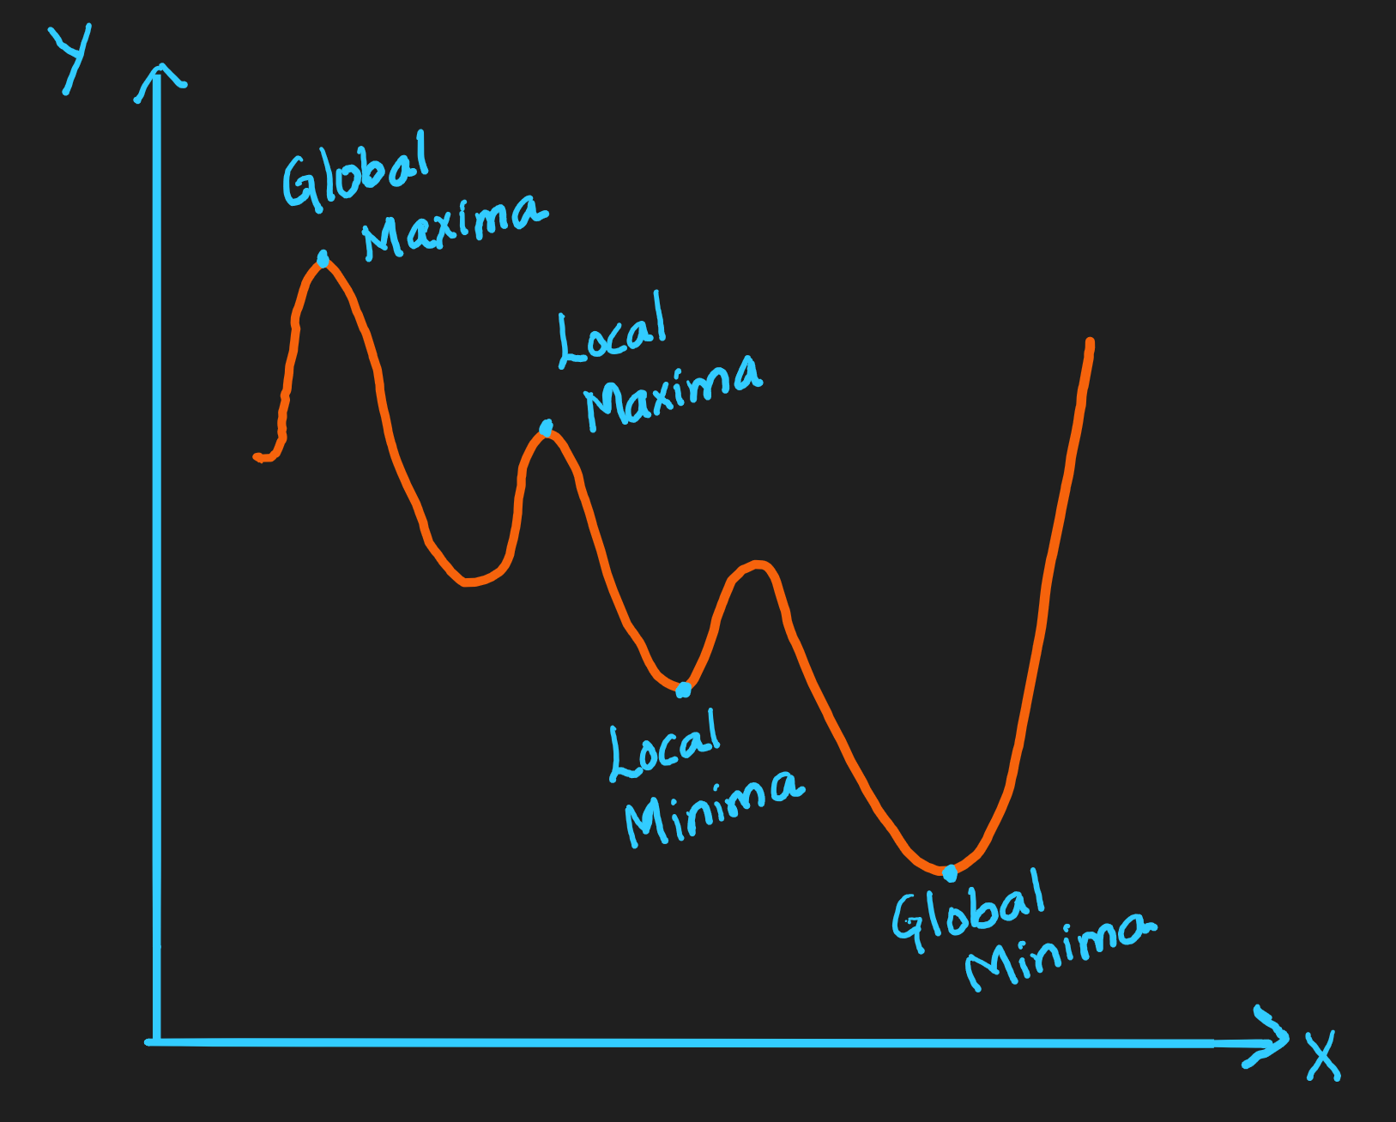

Slide 10
Optimization…
“Optimization is the heart of Machine Learning.”
In machine learning, optimization is the process of finding the best set of model parameters that minimize a loss function or maximize an objective function.
Essentially, it's about making a machine learning model as accurate as possible by adjusting its weights and bias based on the training data.
Optimization algorithms in machine learning are mathematical techniques used to adjust a model's parameters to minimize errors and improve accuracy. These algorithms help models learn from data by finding the best possible solution through iterative updates.

Slide 11
Optimization Algorithms
Simplex Method:
A widely used algorithm for solving linear programming problems
Example: Minimize transport cost.
Gradient Descent:
Iteratively finds minimum error
Finds minima of functions by moving step-by-step downhill

Slide 12
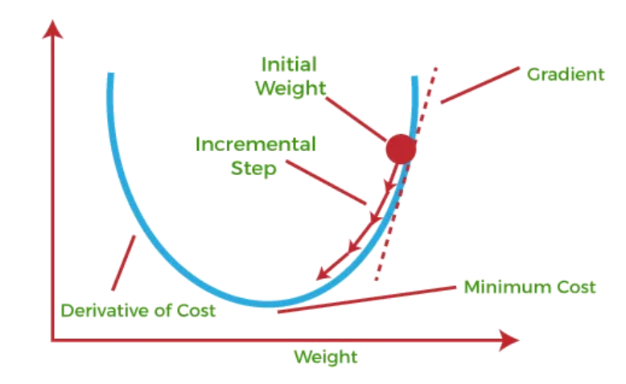
Gradient descent
Gradient descent is an optimization algorithm which is commonly-used to train machine learning models and neural networks. It trains machine learning models by minimizing errors between predicted and actual results.

Slide 13
Why Necessary for Machine Learning
Gradient descent is necessary for optimizing and fine-tuning the parameters of a machine learning model.
Gradient descent aims to minimize a model's cost or loss function.
By reducing the cost function, the model becomes better at making predictions and can generalize better to new data.

Slide 14
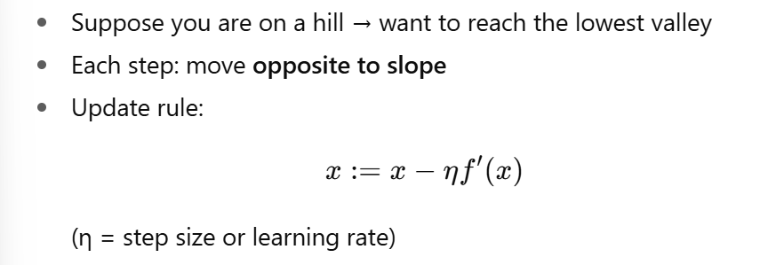
Gradient descent

Slide 15
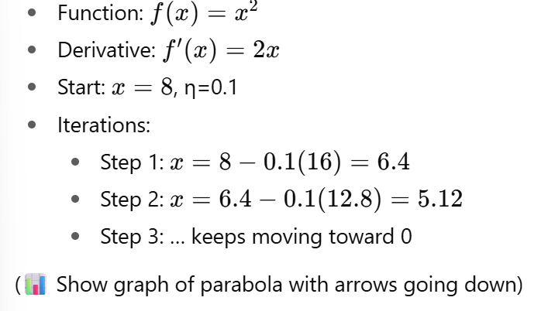
Gradient Descent Example

Slide 16
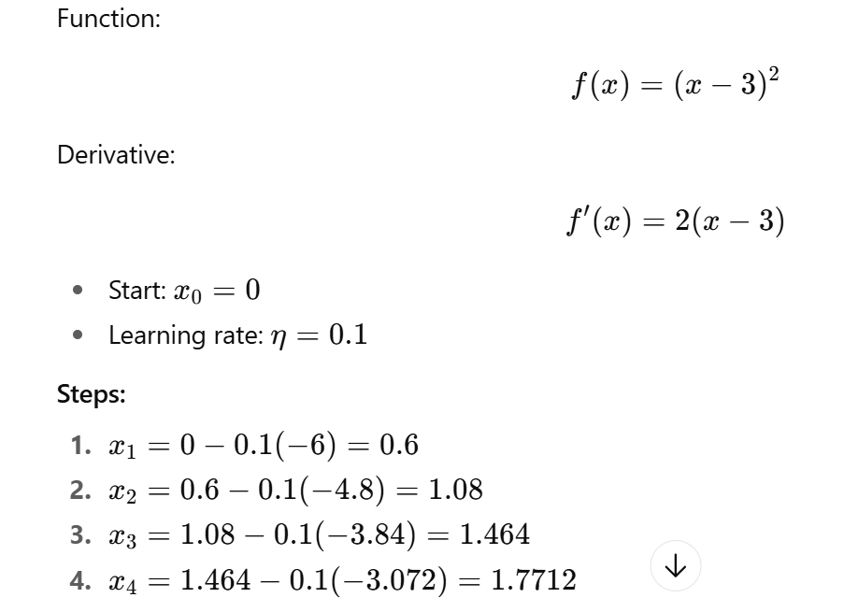
Gradient Descent Example

Slide 17
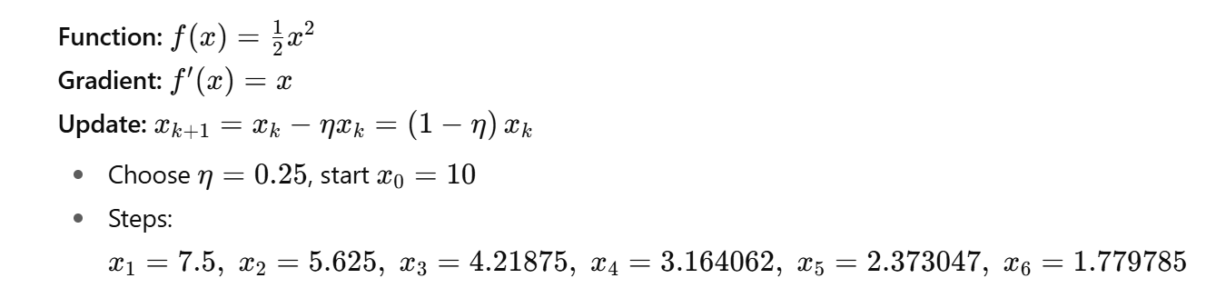

Slide 18
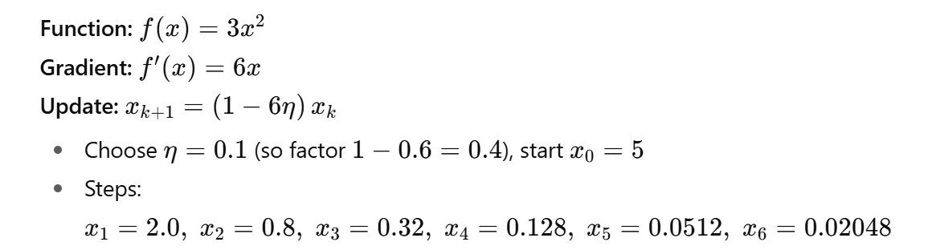

Slide 19
Different Variants of Gradient Descent
There are several variants of gradient descent that differ in the way the step size or learning rate is chosen and the way the updates are made.
Batch Gradient Descent
Stochastic Gradient Descent (SGD)
Mini-batch Gradient Descent

Slide 20
Batch gradient descent
Batch gradient descent sums the error for each point in a training set, updating the model only after all training examples have been evaluated. This process referred to as a training epoch.
While this batching provides computation efficiency, it can still have a long processing time for large training datasets as it still needs to store all of the data into memory.

Slide 21
Stochastic gradient descent
Stochastic gradient descent (SGD) runs a training epoch for each example within the dataset and it updates each training example's parameters one at a time.

Slide 22
Mini-batch gradient descent
Mini-batch gradient descent combines concepts from both batch gradient descent and stochastic gradient descent.
It splits the training dataset into small batch sizes and performs updates on each of those batches.
This approach strikes a balance between the computational efficiency of batch gradient descent and the speed of stochastic gradient descent.

Slide 23
Thank You

